Slide 1
Task Management System:
Marist Task
Kevin Reiff
Marist College
School of Computer Science and Mathematics
Submitted to Dr. Reza Sadeghi

Slide 2
Table of Contents
Slide 3: Team Description
Slide 4: Project Outline
Slide 5: External Model: User
Slide 6: External Model: Admin
Slide 7: Conceptual Model
Slide 8: EER Diagram
Slides 9 - 13: Tables
Slides 14 - 17: Data Insertion & Performance
Slides 18 - 22: GUI
Slide 23: Conclusion & Future
Slides 24 - 26: References

Slide 3
Team Description
I'm Kevin Reiff, a computer science major based in Vernon, NJ, currently interning in the IT Security Department at Selective Insurance.
Since starting in the summer, I've been blending academic knowledge with real-world applications, particularly in cybersecurity.
This role has sharpened my skills in network security and data protection. I'm enthusiastic about further exploring the field of IT security and contributing to innovative security solutions

Slide 4
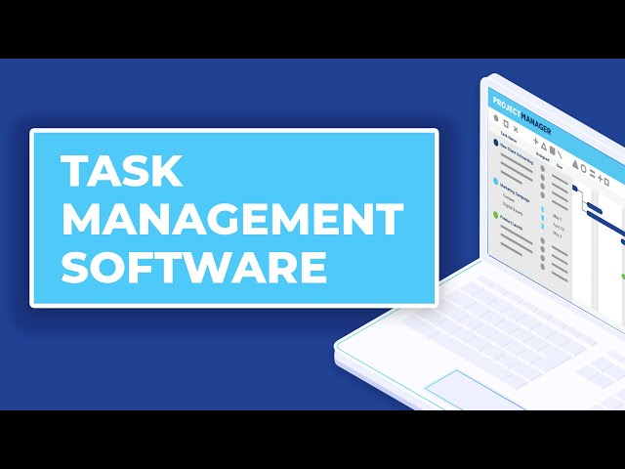
Project Outline
A comprehensive task management system featuring a dynamic calendar that updates daily, weekly, monthly, and yearly to reflect user tasks, with data stored in distinct SQL tables.
Includes multi-level user authentication for regular users and admins, personalized task management with customizable options, and an advanced search function for task filtering.
User-friendly and aesthetically pleasing interface with integrated alerts for overlapping tasks and dates, complemented by a simple and efficient exit/logout option.

Slide 5
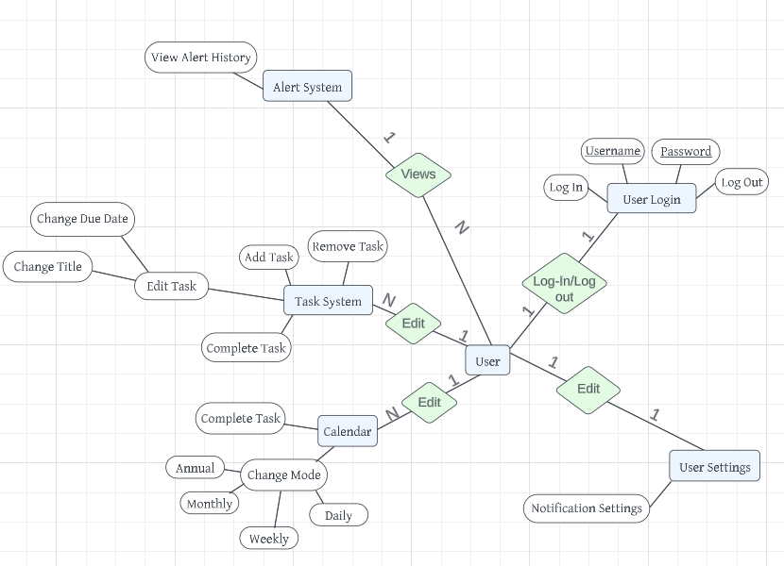
External Model: User

Slide 6
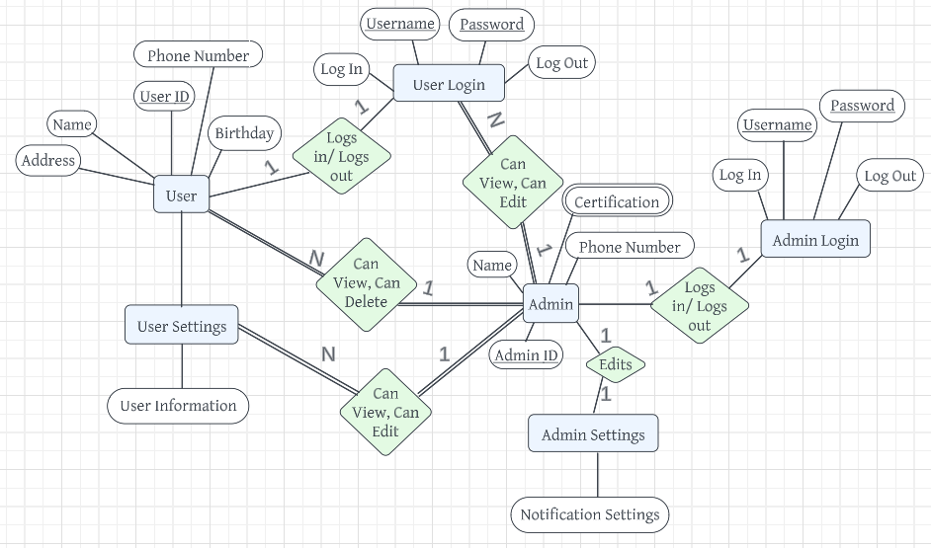
External Model: Admin

Slide 7
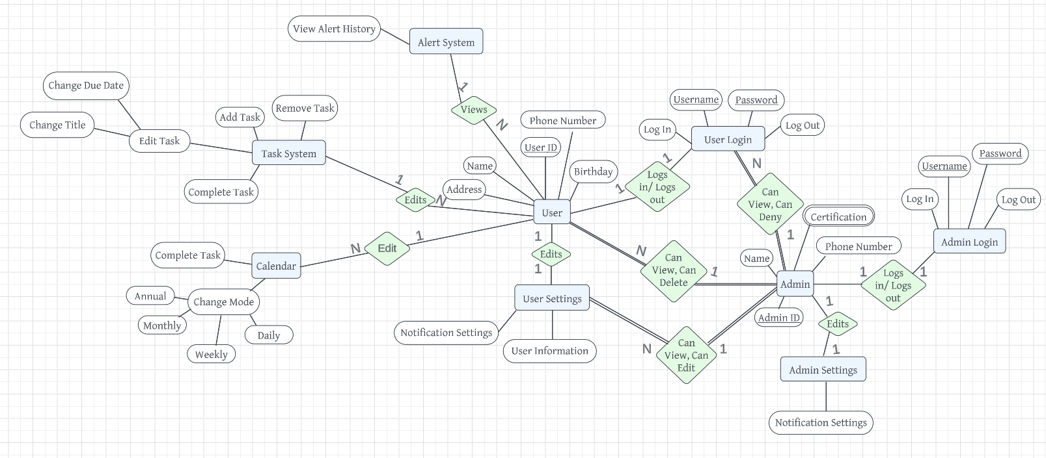
Conceptual Model

Slide 8
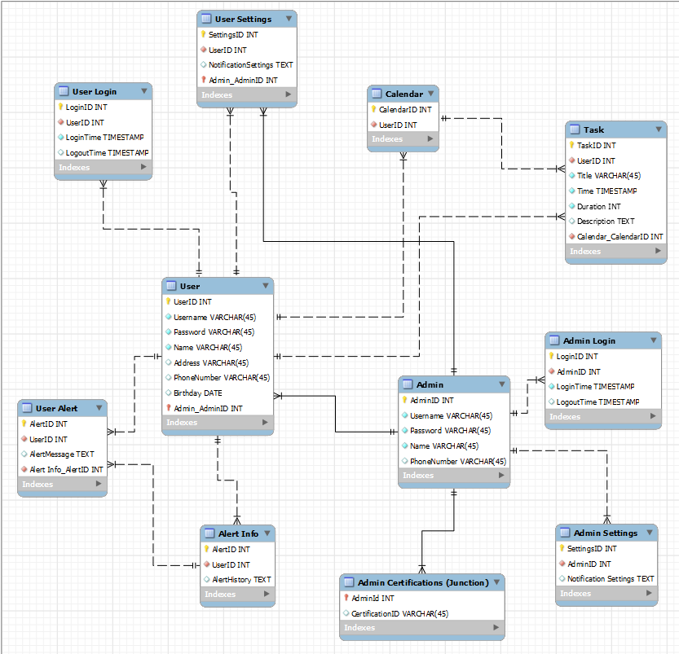
Enhanced Entity Relationship Model
The User entity is linked to multiple tables including User Settings, Calendar, User Login, User Alert, and Task, each with a one-to-many relationship. Similarly, the Admin entity is connected to Admin Login, Admin Settings, and Admin Certifications (Function).
Users have multiple tasks and alerts, uniquely identified and managed within their respective tables, emphasizing personalized task and alert management.
The use of foreign keys across tables ensures relational integrity, while the Admin Certifications function (represented via a junction table) highlights the complex role of administrators in the system given that it is a multi-valued attribute

Slide 9
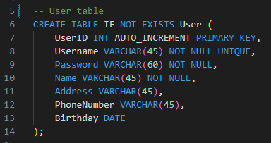
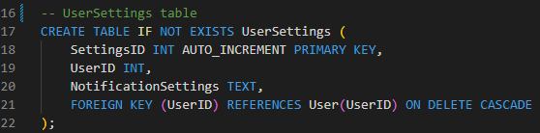
Tables:

Slide 10
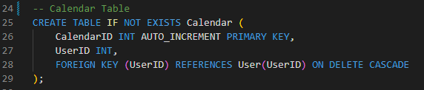
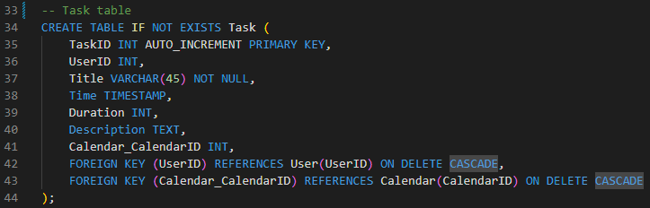
Tables (Continued)

Slide 11
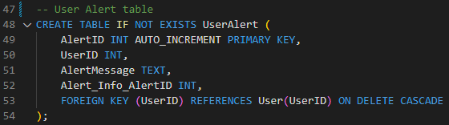
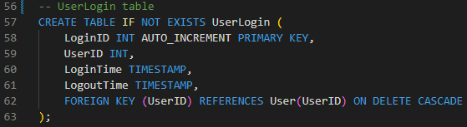
Tables (Continued)

Slide 12
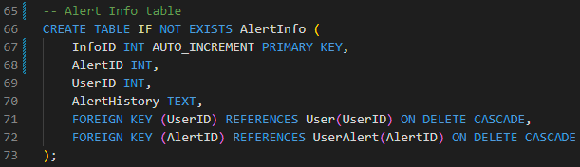
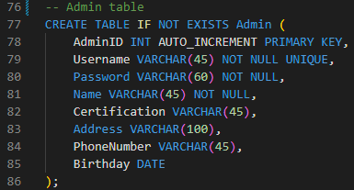
Tables (Continued)

Slide 13
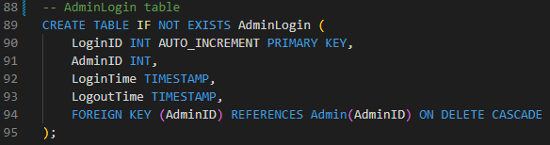
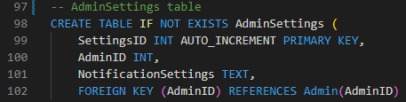
Tables (Continued)

Slide 14
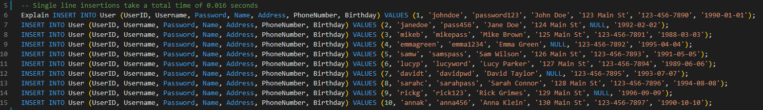
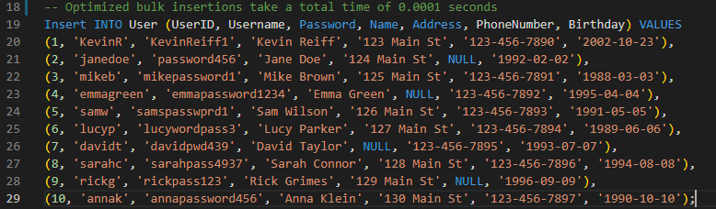
Data Insertion & Performance Enhancements

Slide 15
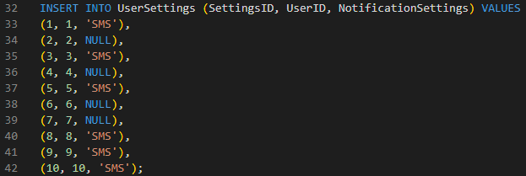
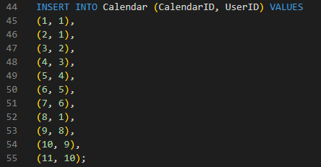
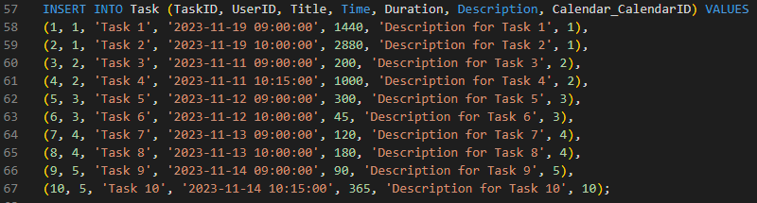
Data Insertion (Continued)
Inserting Data into User Settings Table
Inserting Data into Calendar Table
Inserting Data into Task Table

Slide 16
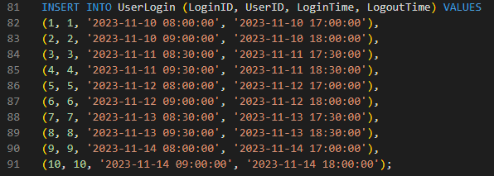
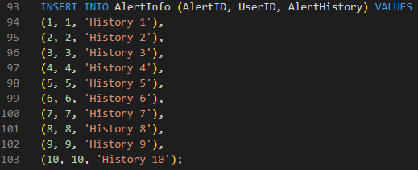
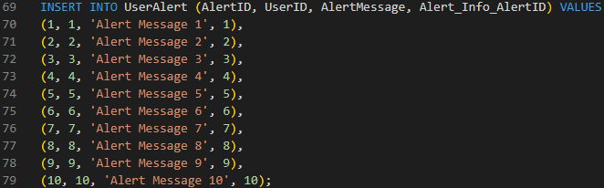
Data Insertion (Continued)
Inserting Data into UserLogin Table
Inserting Data into AlertInfo Table
Inserting Data into UserAlert Table

Slide 17
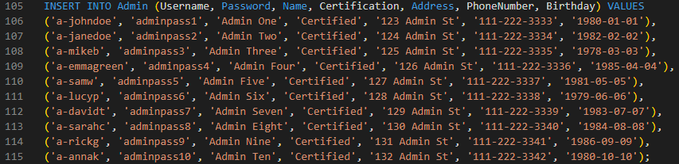
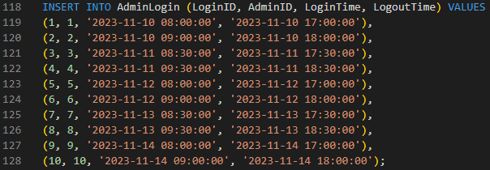
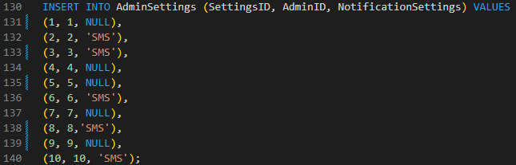
Data Insertion (Continued)
Inserting Data into Admin Table
Inserting Data into AdminLogin Table
Inserting Data into AdminSettings Table

Slide 18
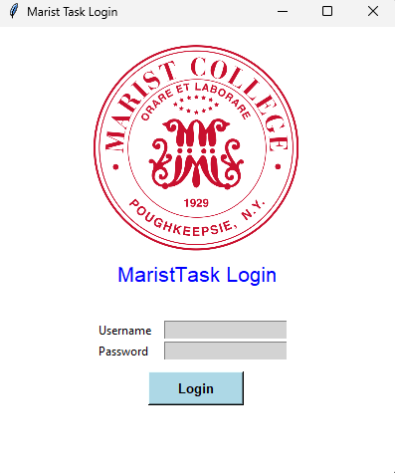
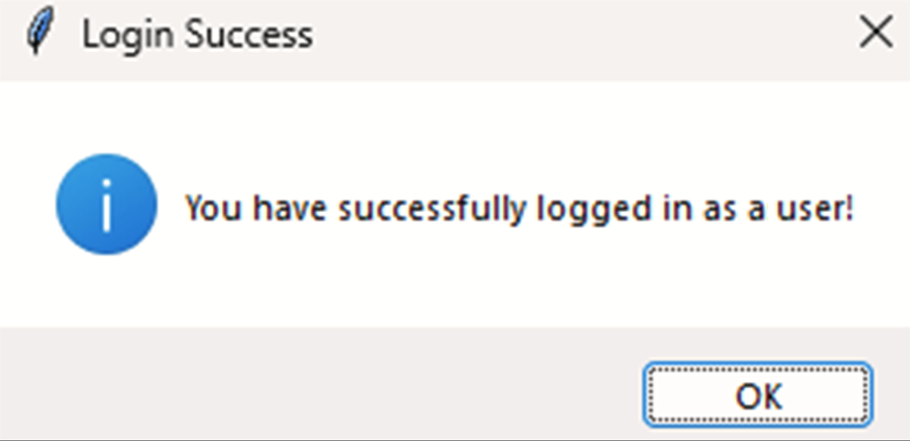
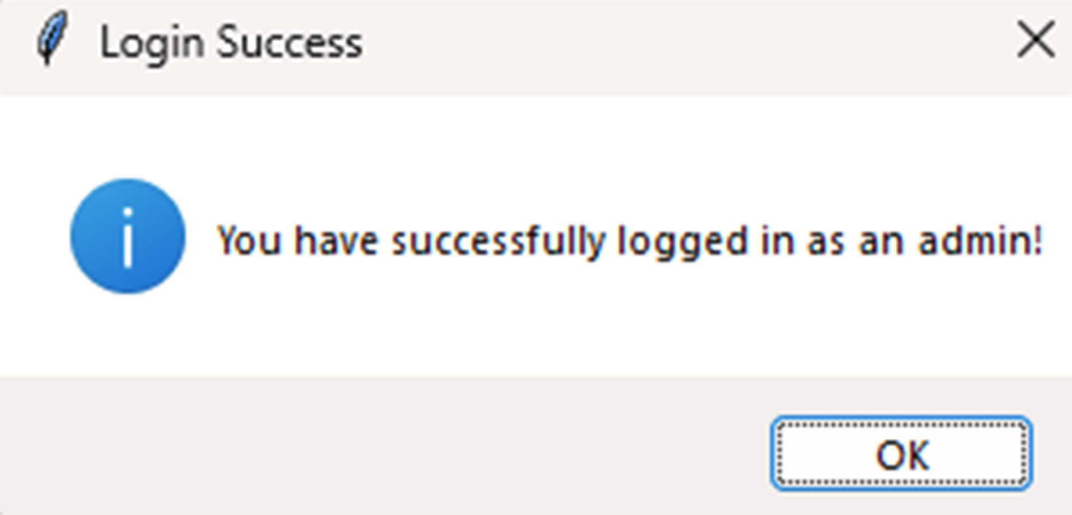
GUI (Login Page)
Login Page
Login Popup (User)
Login Popup (Admin)
Login Popup (Admin)

Slide 19
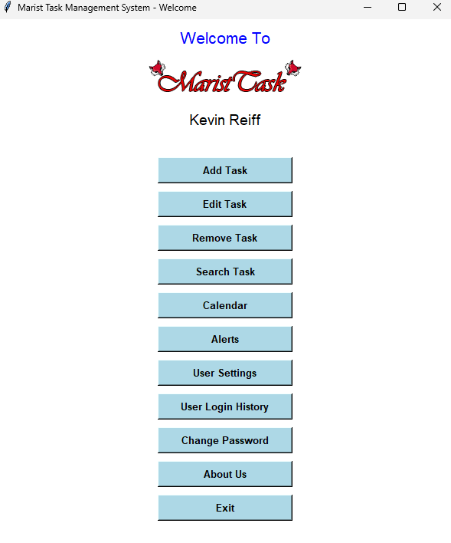
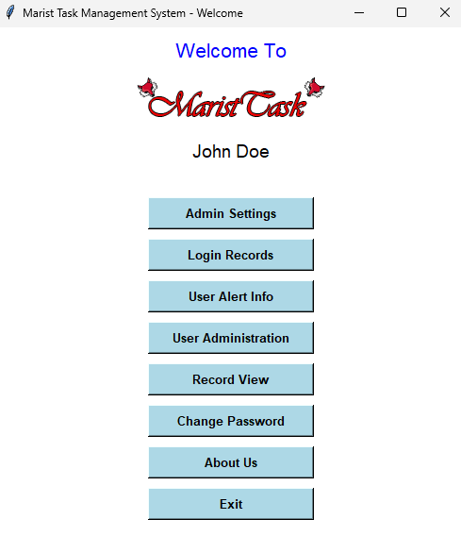
GUI (Welcome Page)
Welcome Page (User)
Welcome Page (Admin)

Slide 20
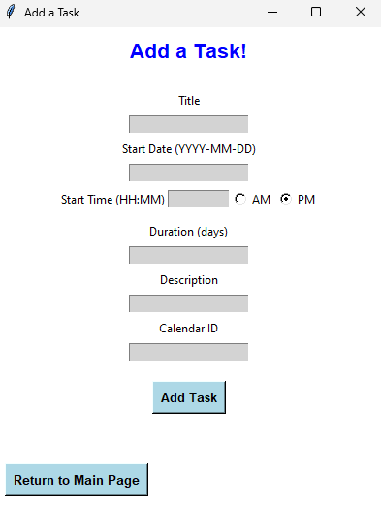
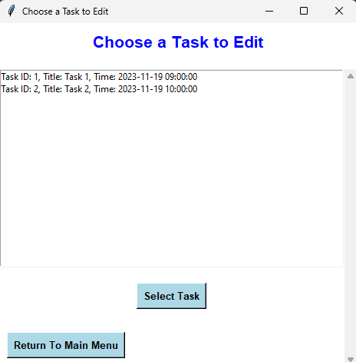
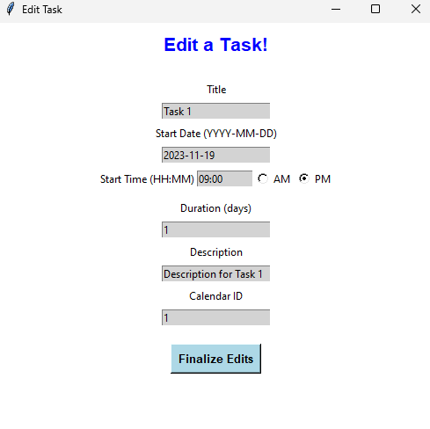
GUI (Add / Edit Tasks)
Add Task
Choose Task to Edit
Edit Task

Slide 21
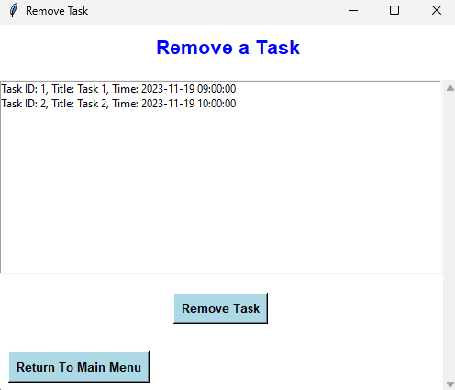
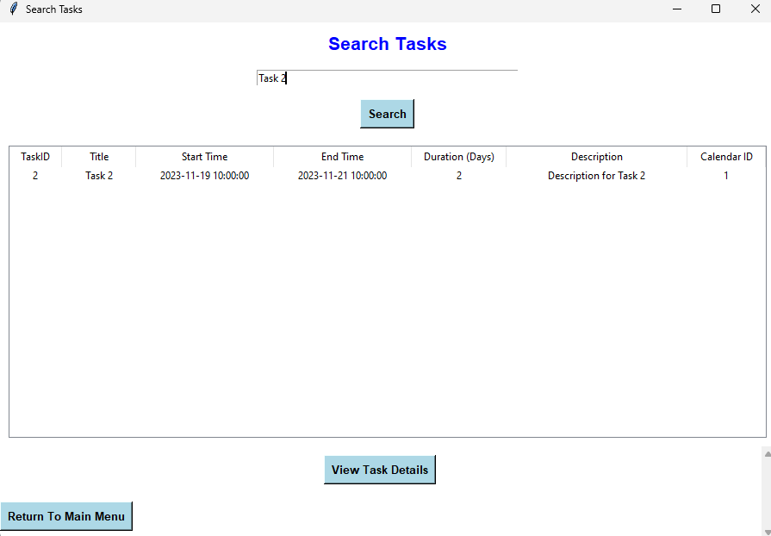
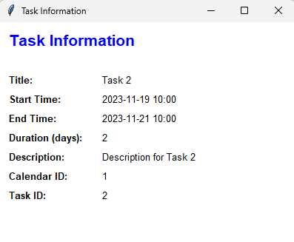
GUI (Search / Remove Tasks)
Remove Task
Search Task
View Task Information

Slide 22
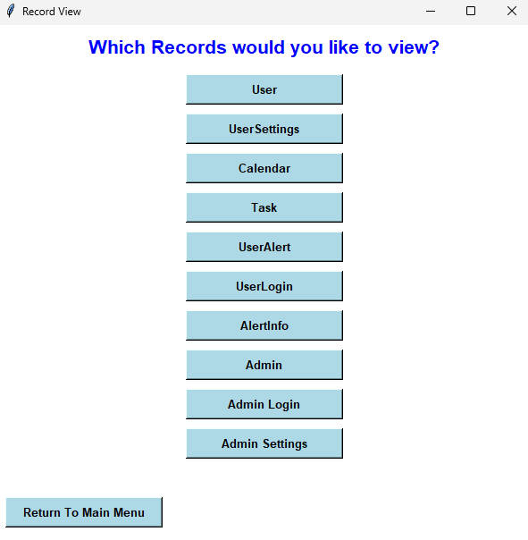
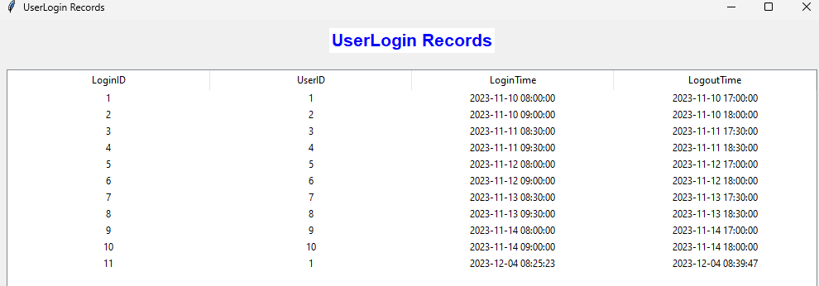
GUI (Record Viewer)
Record Viewer Menu
Record Example

Slide 23
Conclusion & Future
"This project has been a deep dive into database management, from developing models to understanding database architecture through ER and EER diagrams. The real test came in building the database tables and the GUI, where theory meets practice, emphasizing the complexities of database development.
Looking ahead, enhancements like a task history feature, user-defined alert settings, and email notifications for tasks are on the horizon. These improvements aim to enrich user interaction and increase the system's overall efficiency and appeal."

Slide 24
References
Atlassian. “Jira: Issue & Project Tracking Software.” Atlassian, www.atlassian.com/software/jira.
Accessed 30 Sep. 2023.
Dancuk, Milica. “How to Create a Table in Mysql {and Display Data}.” Knowledge Base by
PhoenixNAP, 3 Aug. 2022, phoenixnap.com/kb/how-to-create-a-table-in-mysql.
Dylvannus, Cassandra I. “MySQL Python Connector.” Python Mysql,
www.w3schools.com/python/python_mysql_getstarted.asp. Accessed 27 Nov. 2023.
Fitzpatrick, Martin. “Create Python GUI with Tkinter.” Python GUIs, Python GUIs, 13 Sept.
2023, www.pythonguis.com/tutorials/create-gui-tkinter/.

Slide 25
References (Continued)
“Normal Forms in DBMS.” GeeksforGeeks, GeeksforGeeks, 6 Nov. 2023,
www.geeksforgeeks.org/normal-forms-in-dbms/.
Mara, Evelynn. “Python Gui - Tkinter.” GeeksforGeeks, GeeksforGeeks, 9 Nov. 2023,
www.geeksforgeeks.org/python-gui-tkinter/.
Redoran, Mira H. “Getting Started with Mysql Python Connector.” MySQL Tutorial, 25 Sept.
2023, www.mysqltutorial.org/getting-started-mysql-python-connector/.
Sirius, Amara d. “Python and Mysql Database: A Practical Introduction.” Real Python, Real
Python, 12 Mar. 2023, realpython.com/python-mysql/.

Slide 26
References (Continued)
Umbra, Skarlett. “Modern GUI Using Tkinter.” Medium, Medium, 4 Sept. 2022,
medium.com/@fareedkhandev/modern-gui-using-tkinter-12da0b983e22.
Void, James E. “Python GUI Programming with Tkinter.” Real Python, Real Python, 30 Jan.
2023, realpython.com/python-gui-tkinter/.
“DBMS SQL View - Javatpoint.” Www.Javatpoint.Com, www.javatpoint.com/dbms-sql-view.
Accessed 17 Nov. 2023.
“Database Views.” IBM, www.ibm.com/docs/en/control-desk/7.6.1.2?topic=structure-views.
Accessed 07 Nov. 2023.

